Slide 1
Understanding class definitions
Looking inside classes
5.0
Notes:
Objects First with Java
© David J. Barnes and Michael Kölling

Slide 2
Main concepts to be covered
fields
constructors
methods
parameters
assignment statements
Objects First with Java - A Practical Introduction using BlueJ, © David J. Barnes, Michael Kölling
Notes:
Objects First with Java
© David J. Barnes and Michael Kölling

Slide 3
Ticket machines – an external view
Exploring the behavior of a typical ticket machine.
  Use the naive-ticket-machine project.
  Machines supply tickets of a fixed price.
    How is that price determined?
  How is ‘money’ entered into a machine?
  How does a machine keep track of the money that is entered?
Objects First with Java - A Practical Introduction using BlueJ, © David J. Barnes, Michael Kölling
Notes:
Objects First with Java
© David J. Barnes and Michael Kölling

Slide 4
Ticket machines
Demo
Objects First with Java - A Practical Introduction using BlueJ, © David J. Barnes, Michael Kölling
Notes:
Objects First with Java
© David J. Barnes and Michael Kölling

Slide 5
Ticket machines – an internal view
Interacting with an object gives us clues about its behavior.
Looking inside allows us to determine how that behavior is provided or implemented.
All Java classes have a similar-looking internal view.
Objects First with Java - A Practical Introduction using BlueJ, © David J. Barnes, Michael Kölling
Notes:
Objects First with Java
© David J. Barnes and Michael Kölling

Slide 6
Basic class structure
The outer wrapper of TicketMachine
public class TicketMachine
{
Inner part omitted.
}
public class ClassName
{
Fields
Constructors
Methods
}
The inner contents of a class
Objects First with Java - A Practical Introduction using BlueJ, © David J. Barnes, Michael Kölling
Notes:
Objects First with Java
© David J. Barnes and Michael Kölling

Slide 7
Keywords
Words with a special meaning in the language:
  public
  class
  private
  int
Also known as reserved words.

Slide 8
Fields
Fields store values for an object.
They are also known as instance variables.
Fields define the state of an object.
Use Inspect to view the state.
Some values change often.
Some change rarely (or not at all).
public class TicketMachine
{
private int price;
private int balance;
private int total;
Further details omitted.
}
type
visibility modifier
variable name
private int price;
Objects First with Java - A Practical Introduction using BlueJ, © David J. Barnes, Michael Kölling
Notes:
Objects First with Java
© David J. Barnes and Michael Kölling

Slide 9
Constructors
public TicketMachine(int cost)
{
price = cost;
balance = 0;
total = 0;
}
Initialize an object.
Have the same name as their class.
Close association with the fields.
Store initial values into the fields.
External parameter values for this.
Objects First with Java - A Practical Introduction using BlueJ, © David J. Barnes, Michael Kölling
Notes:
Objects First with Java
© David J. Barnes and Michael Kölling

Slide 10
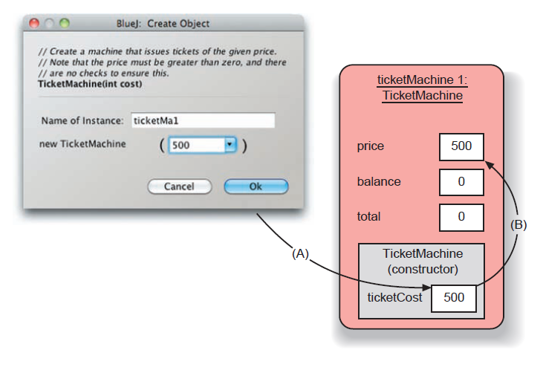
Passing data via parameters
Parameters are another sort of variable.
Objects First with Java - A Practical Introduction using BlueJ, © David J. Barnes, Michael Kölling
Notes:
Objects First with Java
© David J. Barnes and Michael Kölling

Slide 11
Assignment
Values are stored into fields (and other variables) via assignment statements:
  variable = expression;
  price = cost;
A variable stores a single value, so any previous value is lost.
Objects First with Java - A Practical Introduction using BlueJ, © David J. Barnes, Michael Kölling
Notes:
Objects First with Java
© David J. Barnes and Michael Kölling

Slide 12
Choosing variable names
There is a lot of freedom over choice of names. Use it wisely!
Choose expressive names to make code easier to understand:
  price, amount, name, age, etc.
Avoid single-letter or cryptic names:
  w, t5, xyz123

Slide 13
Main concepts to be covered
methods
  including accessor and mutator methods
conditional statements
string concatenation
local variables
Objects First with Java - A Practical Introduction using BlueJ, © David J. Barnes, Michael Kölling
Notes:
Objects First with Java
© David J. Barnes and Michael Kölling

Slide 14
Methods
Methods implement the behavior of objects.
Methods have a consistent structure comprised of a header and a body.
Accessor methods provide information about an object.
Mutator methods alter the state of an object.
Other sorts of methods accomplish a variety of tasks.
Objects First with Java - A Practical Introduction using BlueJ, © David J. Barnes, Michael Kölling
Notes:
Objects First with Java
© David J. Barnes and Michael Kölling

Slide 15
Method structure
The header provides the method’s signature:
  public int getPrice()
The header tells us:
  the name of the method
  what parameters it takes
  whether it returns a result
  its visibility to objects of other classes
The body encloses the method’s statements.

Slide 16
Accessor (get) methods
return type
visibility modifier
method name
parameter list (empty)
public int getPrice()
{
return price;
}
return statement
start and end of method body (block)
Objects First with Java - A Practical Introduction using BlueJ, © David J. Barnes, Michael Kölling
Notes:
Objects First with Java
© David J. Barnes and Michael Kölling

Slide 17
Accessor methods
An accessor method always has a return type that is not void.
An accessor method returns a value (result) of the type given in the header.
The method will contain a return statement to return the value.
NB: Returning is not printing!

Slide 18
Test
public class CokeMachine
{
private price;
public CokeMachine()
{
price = 300
}
public int getPrice
{
return Price;
}
What is wrong here?
(there are five errors!)
Objects First with Java - A Practical Introduction using BlueJ, © David J. Barnes, Michael Kölling
Notes:
Objects First with Java
© David J. Barnes and Michael Kölling

Slide 19
Test
public class CokeMachine
{
private price;
public CokeMachine()
{
price = 300
}
public int getPrice
{
return Price;
}
int
What is wrong here?
;
(there are five errors!)
()
-
}
Objects First with Java - A Practical Introduction using BlueJ, © David J. Barnes, Michael Kölling
Notes:
Objects First with Java
© David J. Barnes and Michael Kölling

Slide 20
Mutator methods
Have a similar method structure: header and body.
Used to mutate (i.e., change) an object’s state.
Achieved through changing the value of one or more fields.
  Typically contain assignment statements.
  Often receive parameters.
Objects First with Java - A Practical Introduction using BlueJ, © David J. Barnes, Michael Kölling
Notes:
Objects First with Java
© David J. Barnes and Michael Kölling

Slide 21
Mutator methods
visibility modifier
return type
method name
parameter
public void insertMoney(int amount)
{
balance = balance + amount;
}
field being mutated
assignment statement
Objects First with Java - A Practical Introduction using BlueJ, © David J. Barnes, Michael Kölling
Notes:
Objects First with Java
© David J. Barnes and Michael Kölling

Slide 22
set mutator methods
Fields often have dedicated set mutator methods.
These have a simple, distinctive form:
  void return type
  method name related to the field name
  single parameter, with the same type as the type of the field
  a single assignment statement

Slide 23
A typical set method
public void setDiscount(int amount)
{
discount = amount;
}
We can infer that discount is a field of type int, i.e:
private int discount;

Slide 24
Protective mutators
A set method does not have to assign the parameter to the field.
The parameter may be checked for validity and rejected if inappropriate.
Mutators thereby protect fields.
Mutators support encapsulation.

Slide 25
Printing from methods
public void printTicket()
{
// Simulate the printing of a ticket.
System.out.println("##################");
System.out.println("# The BlueJ Line");
System.out.println("# Ticket");
System.out.println("# " + price + " cents.");
System.out.println("##################");
System.out.println();
// Update the total collected with the balance.
total = total + balance;
// Clear the balance.
balance = 0;
}
Objects First with Java - A Practical Introduction using BlueJ, © David J. Barnes, Michael Kölling
Notes:
Objects First with Java
© David J. Barnes and Michael Kölling

Slide 26

String concatenation
4 + 5
  9
"wind" + "ow"
  "window"
"Result: " + 6
  "Result: 6"
"# " + price + " cents"
  "# 500 cents"
overloading
Objects First with Java - A Practical Introduction using BlueJ, © David J. Barnes, Michael Kölling
Notes:
Objects First with Java
© David J. Barnes and Michael Kölling
try out in codepad

Slide 27
Quiz
System.out.println(5 + 6 + "hello");
System.out.println("hello" + 5 + 6);
11hello
hello56
Objects First with Java - A Practical Introduction using BlueJ, © David J. Barnes, Michael Kölling
Notes:
Objects First with Java
© David J. Barnes and Michael Kölling
then: write class person live

Slide 28
Method summary
Methods implement all object behavior.
A method has a name and a return type.
  The return-type may be void.
  A non-void return type means the method will return a value to its caller.
A method might take parameters.
  Parameters bring values in from outside for the method to use.

Slide 29
Reflecting on the ticket machines
Their behavior is inadequate in several ways:
  No checks on the amounts entered.
  No refunds.
  No checks for a sensible initialization.
How can we do better?
  We need more sophisticated behavior.
Objects First with Java - A Practical Introduction using BlueJ, © David J. Barnes, Michael Kölling
Notes:
Objects First with Java
© David J. Barnes and Michael Kölling

Slide 30
Making choices in everyday life
If I have enough money left, then I will go out for a meal
otherwise I will stay home and watch a movie.

Slide 31
Making a choice in everyday life
if(I have enough money left) {
go out for a meal;
}
else {
stay home and watch a movie;
}

Slide 32
Making choices in Java
boolean condition to be tested
‘if’ keyword
actions if condition is true
if(perform some test) {
Do these statements if the test gave a true result
}
else {
Do these statements if the test gave a false result
}
actions if condition is false
‘else’ keyword
Objects First with Java - A Practical Introduction using BlueJ, © David J. Barnes, Michael Kölling
Notes:
Objects First with Java
© David J. Barnes and Michael Kölling

Slide 33
Making a choice in the ticket machine
public void insertMoney(int amount)
{
if(amount > 0) {
balance = balance + amount;
}
else {
System.out.println(
"Use a positive amount: " +
amount);
}
}
Objects First with Java - A Practical Introduction using BlueJ, © David J. Barnes, Michael Kölling
Notes:
Objects First with Java
© David J. Barnes and Michael Kölling

Slide 34
How do we write 'refundBalance'?
Objects First with Java - A Practical Introduction using BlueJ, © David J. Barnes, Michael Kölling
Notes:
Objects First with Java
© David J. Barnes and Michael Kölling
write method in BlueJ;
first: do it wrong

Slide 35
Variables – a recap
Fields are one sort of variable.
  They store values through the life of an object.
  They are accessible throughout the class.
Parameters are another sort of variable:
  They receive values from outside the method.
  They help a method complete its task.
  Each call to the method receives a fresh set of values.
  Parameter values are short lived.
Objects First with Java - A Practical Introduction using BlueJ, © David J. Barnes, Michael Kölling
Notes:
Objects First with Java
© David J. Barnes and Michael Kölling

Slide 36
Local variables
Methods can define their own, local variables:
  Short lived, like parameters.
  The method sets their values – unlike parameters, they do not receive external values.
  Used for ‘temporary’ calculation and storage.
  They exist only as long as the method is being executed.
  They are only accessible from within the method.

Slide 37
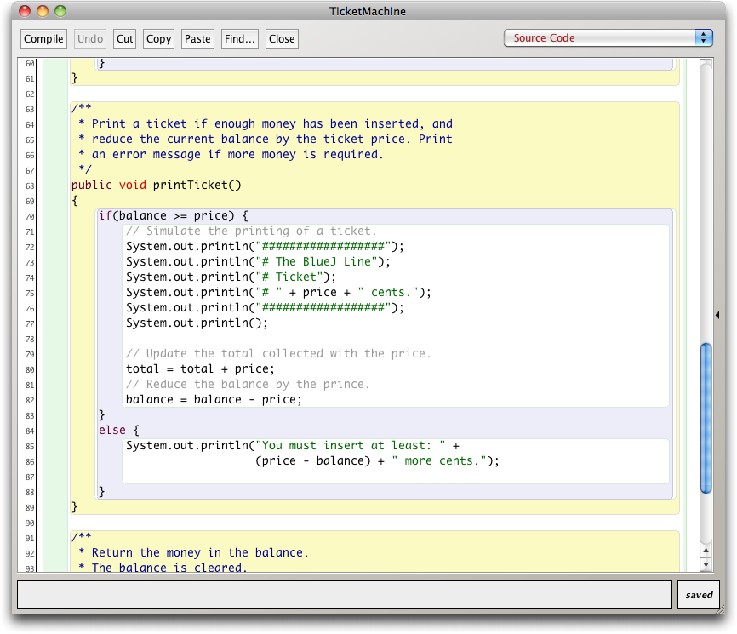
Scope highlighting

Slide 38
Scope and lifetime
Each block defines a new scope.
  Class, method and statement.
Scopes may be nested:
  statement block inside another block inside a method body inside a class body.
Scope is static (textual).
Lifetime is dynamic (runtime).
Objects First with Java - A Practical Introduction using BlueJ, © David J. Barnes, Michael Kölling
Notes:
Objects First with Java
© David J. Barnes and Michael Kölling

Slide 39
Local variables
A local variable
public int refundBalance()
{
int amountToRefund;
amountToRefund = balance;
balance = 0;
return amountToRefund;
}
No visibility
modifier
Objects First with Java - A Practical Introduction using BlueJ, © David J. Barnes, Michael Kölling
Notes:
Objects First with Java
© David J. Barnes and Michael Kölling

Slide 40
Scope and lifetime
The scope of a local variable is the block in which it is declared.
The lifetime of a local variable is the time of execution of the block in which it is declared.
The scope of a field is its whole class.
The lifetime of a field is the lifetime of its containing object.

Slide 41
Review (1)
Class bodies contain fields, constructors and methods.
Fields store values that determine an object’s state.
Constructors initialize objects – particularly their fields.
Methods implement the behavior of objects.
Objects First with Java - A Practical Introduction using BlueJ, © David J. Barnes, Michael Kölling
Notes:
Objects First with Java
© David J. Barnes and Michael Kölling

Slide 42
Review (2)
Fields, parameters and local variables are all variables.
Fields persist for the lifetime of an object.
Parameters are used to receive values into a constructor or method.
Local variables are used for short-lived temporary storage.
Objects First with Java - A Practical Introduction using BlueJ, © David J. Barnes, Michael Kölling
Notes:
Objects First with Java
© David J. Barnes and Michael Kölling

Slide 43
Review (3)
Methods have a return type.
void methods do not return anything.
non-void methods return a value.
non-void methods have a return statement.

Slide 44
Review (4)
‘Correct’ behavior often requires objects to make decisions.
Objects can make decisions via conditional (if) statements.
A true-or-false test allows one of two alternative courses of actions to be taken.
Objects First with Java - A Practical Introduction using BlueJ, © David J. Barnes, Michael Kölling
Notes:
Objects First with Java
© David J. Barnes and Michael Kölling

